Slide 1
THE CURATION OF SMART GOVERNMENTS:
A PERSONAL JOURNEY

Slide 2
Personal Journey
Richness of Agriculture, Natural Resources, and Food Policy

Slide 3
Selected Research Publications
“Political Economic Markets: PERTs and PESTs in Food and Agriculture.” Keynote address to the American Agricultural Economics Association Annual Meetings. Logan, Utah 1982. Published in the American Journal of Agricultural Economics. Reprinted in The WTO and Agriculture, Anderson K, Josling T. Edward Elgar. Provided basis for SSAAP conference and task force led by Glenn Johnson and James Bonnen.
Rausser GC. 1992. Predatory Versus Productive Government: The Case of U.S. Agricultural Policy. Journal of Economic Perspectives, 6(3):133–57.
Rausser GC, Foster WE. 1990. Political Preference Functions and Public Policy Reform. American Journal of Agricultural Economics, 72(3):642–52. Reprinted in Agro-Environmental Policy, Batie SS, Horan R, eds. Aldershot, UK: Ashgate Publishing.
Foster WE, Rausser GC. 1993. Price Distorting Compensation Serving the Consumer and Taxpayer Interest. Public Choice, 77(2):275–91.
Rausser GC, Goodhue RE. 2002. Public Policy: Its Many Analytical Dimensions. In Handbook of Agricultural Resource Economics, Vol 2, Ch 39, Gardner BL, Rausser GC, eds., 2058–102. Amsterdam: Elsevier Science, North Holland.
Rausser GC, Swinnen J, Zusman P. 2011. Political Power and Economic Policy: Theory, Analysis, and Empirical Applications Cambridge: Cambridge University Press
Foster, William, Jill J. McCluskey, and David Zilberman. “The Way Forward.” Modern Agricultural and Resource Economics and Policy: Essays in Honor of Gordon Rausser, Springer, 24 June 2022, pp. 457–480.
Rausser, G., Foster, W. The Curation of Smart Governments. In Preparation.

Slide 4
Gratitude to Collaborators
Another more than 50+ political-economic refereed publications have relied heavily on the number of remarkable economists whose friendships I will forever cherish: George Akerlof, Kym Anderson, Richard Ball, Kathy Baylis, Jagdish Bhagwati, Harry de Gorter, Alain de Janvry, John Freebairn, William Foster, Bruce Gardner, Rachael Goodhue, Richard Gray, Al Harberger, Richard Howitt, Doug Irwin, Stan Johnson, Richard Just, Alan Love, Jill McCluskey, Yair Mundlak, Mansur Olson, Gerard Roland, Elisabeth Sadoulet, Leo Simon, Joe Stiglitz, Johan Swinnen, Jean Tirole, Gordon Tullock, David Zilberman, Pinhas Zusman.

Slide 5
Political Appointments
Senior Economist, Council of Economic Advisers (1986-87)
  Coincidental with the initiation of the Uruguay Round of the GATT Negotiations
Chief Economist, Agency for International Development, U.S. State Department (1988-90)
  Coordination with the Chief Economists of the World Bank and the IMF, following the collapse of the Soviet Union.
President, Institute for Policy Reform (1990-94)
  Clague C, Rausser GC. 1992. The Emergence of Market Economies in Eastern Europe Cambridge, MA: Blackwell Publishers
Notes:
I am going to talk about political economy and how I see the role of economists generally -- and of the role of agricultural, resource and applied economics -- in both descriptive and prescriptive policy analyses. Because this is the Galbraith lecture, I should say a few things about the man. First, much of Galbraith’s work related to political economy was motivated by the same concerns for realism that has motivated my own work. We, of course, would differ regarding emphasis, and differ regarding the structure of our analytical models. But we would agree that we should treat the political process as integral to economic performance, welfare, and policy formation.
Galbraith’s policy advice begins by recognizing that economic behavior is embedded in institutions and social structures, not merely in models of individual rational choice. During his long, productive life, he saw the rise of the managerial economy and state, of large corporate power and mass consumption. And he recognized that the standard model of a night watchman government tending over highly competitive firms and atomized customers was inadequate to the task of informing real-world policy. The key implication of Galbraith’s basic model that I want to highlight is that politicians have to work within the economic system and political landscape as they are, not as we want them to be.

Slide 6
Unbalanced Growth and the Political Economy
If losers have sufficient political power, they will block growth policy proposals.
Concrete Example: NAFTA
  Fresh produce imports surged: domestic share of avocados (100% → 10%), fruits (69% → 41%), and vegetables (91% → 65%)
  Automotive supply chains globalized: vehicle imports rose (18% → 42%), domestic content fell (73% → 40%), and Mexico’s production share grew (6% → 20%).
  Bill Clinton (1993): “NAFTA means jobs. American jobs, and good-paying American jobs.”
  Ross Perot (1992): “You’re going to hear a giant sucking sound of jobs being pulled out of this country.”
As Deaton & Case (2020) show, these dynamics contributed to deaths of despair and political backlash.
Key Lesson: Even pro-growth reforms require smart, credible compensatory policy to ensure the long-run viability of unbalanced growth policies.
UNBALANCED GROWTH AND THE POLITICAL ECONOMY

Slide 7
Political Economic Models
Economic textbooks falsely divide policies into "good" (pie-expanding) and "bad" (redistributive, rent-seeking)
Government policies emerge from complex power dynamics between competing interest groups
Rent-seeking effectiveness depends on group size, media influence, electoral structures, and free-rider solutions
Rausser et al. (2011) identifies six explanatory schools of thought, none offering policy prescriptions
Conventional welfare analysis fails in environments with imbalanced political power
POLITICAL ECONOMIC MODELS

Slide 8
The Construction of PERTs and PESTs
Two fundamental types of policies
Pure public goods: don’t embrace complete set of pie-expanding policies.
Political-economic resource transaction (PERT) policies: structured to reduce or resolve problems of coordination failures, ill-defined property rights, free-riding and the offering of pure public goods, as well as obstacles to economic growth already in place due to existing institutions and government actions implemented in the past.
SMART POLICIES

Slide 9
The Construction of PERTs and PESTs
Pure redistributive instruments fail to embrace the complete set of redistribution policies.
Political-economic seeking transfer (PEST) policies: compensatory, redistributive policies to offset short-term losses that interest groups may suffer
Conclusion: when accounting for political-economic processes, we need a more insightful theme on how PERTs should be combined simultaneously with PESTs.
SMART POLICIES

Slide 10
Smart Policies
Standard economist’s advice: range from gov’ts being run by angels to gov’ts only manipulated to serve powerful interests.
Blunt rule :
  more pie-expanding policies – PERTs – & fewer redistributionist policies – PESTs.
If we as economists want to provide realistic and useful advice and counsel for sound economic policies, neither of these two extreme approaches will suffice.
SMART POLICIES

Slide 11
Smart Policies
Prescriptive advice: we must understand the political-economic landscape. When accounting for the political economic processes, a new rule emerges:
  more PERTs and better “smart” PESTs
Challenge: design creatively smart PESTs to support introduction of PERTs.
Smart governments would account for the variability of political-economic processes and simultaneously utilize and pie-expanding PERTS and more complementary redistributive PESTs.
SMART POLICIES

Slide 12
Attributes of smart “PESTs”: 3 main attributes
Sunsetting: the search for credible governmental commitments
Political & Economic Complementarities
  Immobility and concentration of the ownership of resources results in the concentration-diffusion predicament (the power of the few)
  short run: PESTs must promote the pie-expanding potential of PERT
  long run: PEST complementary to PERT must improve asset mobility and diversification.
reduced rent-seeking: lower incentives for formation of interest groups to lobby for supporting subsidies or PESTs to sustain and extend rents.
Portfolio of PERTs and PESTs results in more evenly distributed political-economic power by overcoming opposition to the introduction of a PERT, ultimately providing opportunities for sustainable & inclusive economic growth.
SMART POLICIES

Slide 13
Concrete Examples
Patents
PERT: Encouragement of private research and development
PEST: time-limited market distortions for patented products
Major example of simultaneous implementation of both PERT and PEST policies
“intellectual property” protection is a key public policy in promoting diffused innovation efforts in a competitive capitalist system
The PEST outcome results from the wedge between marginal social costs and marginal social benefits.
This portfolio of policies does not achieve economic complementarity.
There remains huge incentives for organized group rent seeking.
Violates second and third attributes of smart PESTs
PATENTS

Slide 14
Regulatory Agencies & Economic Regulation
Intended PERT: Regulatory agencies to protect and advance public interest
PEST: regulatory capture by incumbents engaged in increasing barriers to entry and reducing supply
Variation of PERT-PEST framework in which PERT migrates into PEST
Civil Aeronautics Board, Surface Transportation Board, Interstate Commerce Commissions: controlled entry standards, coordinated supply and instituted market segmentation of various transportations
Certificate of Needs: incumbent healthcare providers increasing barriers to entry
Violates all attributes of smart PESTs
REGULATORY AGENCIES AND RAIL INVESTMENTS
Rail Investments
PERT: Lowered transaction costs and coordination failures
PEST: Land grants subsidization by land ownership
Land grants of 175 million acres to railroad companies, which required them to use American steel
Reduced the coordination costs of private actors interested in building railroads, increased the incentives to take on the risks of a continental project, while assuring political support from a broad base of interest groups.
Satisfies all three attributes of smart PESTs

Slide 15
SUCCESSES OF THE GREEN REVOLUTION
India
PERT: Flood-resistant rice
PEST: Input subsidies for Swarna-Sub1 seeds & financing of demonstration plots
Rice yield increased 10% overall; farmers who used Swarna-Sub1 seeds produced 45% higher yields on fields that were flooded for 10 days
Demand increased after subsidies ended; production increased from 300 megatons in 2012 to over 6,000 megatons in 2015
Satisfies all three attributes
Mozambique
PERT: superior maize seeds combined with fertilizer reformulation
PEST: Smart input subsidies to adopt seeds and fertilizer
Maize yield increased 22% during subsidized year
Spillover effects of subsidized farmer’s experience resulted in unsubsidized farmers using 78% more fertilizer and had 85% larger maize yields after termination of subsidies
Satisfies all three attributes

Slide 16
INDUSTRIAL POLICIES
South Korea (1960s-1980s)
PERT: R&D investments
PEST: Conditional private sector subsidies based on competitiveness in global markets
Utilized export-oriented industrialization with government subsidies/protection based on competitiveness on global market
Considered successful (Four Asian Tigers) despite the emergence of conglomerates that continue to capture economic & political power
Satisfies the first and second attribute
Brazil (1950s-1990s)
PERT: Reduce coordination failures and capture Marshallian externalities
PEST: Protection of domestic manufacturing (tariff and quota subsidies)
Utilized import substitution industrialization
resulted in failure; overprotected nascent industries lacked competitive advantage and agglomeration externalities; resulted in hyperinflation and reliance on foreign corporations
Did not satisfy any attributes

Slide 17
Political Viability Underlying Smart Governments
Differing interests exist, but suppressing PERTs leaves opportunities untapped.
Smart politicians act as entrepreneurs.
Unbalanced PERTs prevail.
Impact based on household asset portfolios.
Balanced PERTs are not only highly unlikely, but uninteresting.
Most effective PERT and PEST combinations are those implemented simultaneously and designed to be complementary and minimally distortionary, ensuring political conditions lean into PERT implementation.
POLITICAL VIABILITY

Slide 18
Modeling the Political Economic Process
            Welfare transformation frontier (Zusman 1976, Gardner 1983).
Specifies constraints faced by governments and interest groups.
Any rebalancing of potential welfare levels of different groups are constrained by the transformation frontier
Curvature of the frontier reflects the efficiency with which policies could transfer welfare from one group to another.
We focus on the trade-off between the welfare levels of two groups to streamline the intuition:
    - a single organized interest group A
    - rest of society group R
WELFARE TRANSFORMATION FRONTIER

Slide 19
Welfare Transformation Frontier
S_{a}
S_{b}
Welfare Group R
a
b
c
Welfare Group A
Notes:
Point a is the social optimum in which the tradeoff between the welfare between the two groups is one to one.
Sa represents welfare of group R if it were possible to first attain the combination of welfare levels at point a and then costlessly transfer all group A’s welfare to group R.
Point b represents an enhancement of group A’s welfare
Sb represents below optimal welfare levels for Group R
The red curve represents the policy indifference curve in terms of governmental welfare/political support; positioning stems from governance structures
Point c represents net welfare value after accounting for lobbying/influence costs
The red slope is the greater weight in the governance function placed on group A relative to group R
Greater the weight on total social welfare, the more effort a group would have to make to shift welfare outcomes to some other points along the frontier

Slide 20
Political Complementarity
G
b
Welfare Group R
e
d
c
F
a
F
Welfare Group A
Notes:
Welfare transformation frontiers will shift as a result of the introduction of a PERT policy.
If the growth of the pie-expansion is unbalanced, we must visit the question of political complementarity.
Some interest groups may benefit while others may lose absolutely.
Depending on the obstructionist behavior or any notions of fairness, the design of a compensatory PEST should be considered.
This explains why the “Washington Consensus” must be rejected. The conditions by the World Bank for loans to country governments have failed miserably. As I’ve argued on numerous occasions, the correct answer is to get the governance structure right.

Slide 21
Economic Complementarity
G
d
H
Welfare Group R
g
f
c
e
F
a
F
H
Welfare Group A
Notes:
Some redistributive policies might even be economically complementary to the pie-expanding PERT policy.
Initially, the political complementarity goal of gaining acceptance in political support for the PERT must be achieved.
More simply, smart PESTs generate incentives for investment that reduce the negative effects of the PERT on losing groups.
Ultimately, a well-designed compensatory smart PEST would encourage mobility and/or asset diversification.
Such outcomes will relax the overall constraint on the flexibility of resources, potentially compounding the effects of the PERT policy.
In a world of complete mobility and/or asset diversification across all households, there will be no incentives for rent-seeking.

Slide 22
MOBILITY AND DIVERSITY OF HOUSEHOLD ASSETS
Major Causal Components of Economic Complementarities: Mobility and Diversity of Household Assets
Asset’s value reflects present discounted value of income flow it generates.
Focus on the household’s portfolio of assets – factors of production.
Two industries, competitive firms, (initially) identical technologies, producing income distributed to factor owners via wages equal to marginal products.
A simple PERT: pure productivity increase in one, favored industry. Owners (who can profitably do so) shift their assets between industries.
But factors vary by their cost of moving: we measure mobility by the wedge driven between the wages of the two industries.

Slide 23
MOBILITY AND DIVERSITY OF HOUSEHOLD ASSETS
Major Causal Components of Economic Complementarities: Mobility and Diversity of Household Assets
To illustrate the critical importance of mobility and diversification, we strip out of the model some interesting but distracting complications. In particular:
  Firms identical except a productivity shock to one industry
  PERT: “neutral technical change” for favored industry.
  No Stolper-Samuelson factor intensity effects.
  Identical, homothetic preferences
    Allows mapping of welfare effects to income changes.

Slide 24
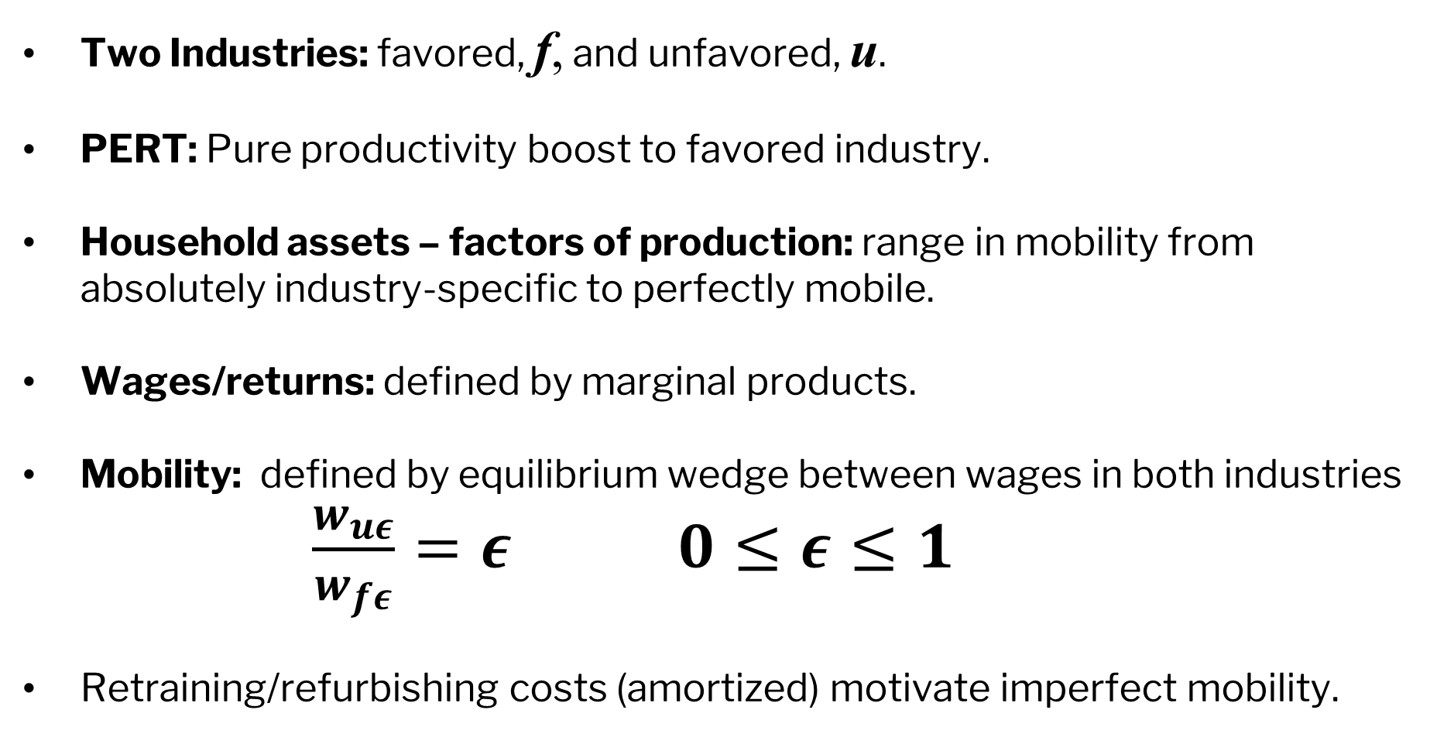
CES Production Framework with Productivity Shock
Two Industries: favored, f, and unfavored, u.
PERT: Pure productivity boost to favored industry.
Household assets – factors of production: range in mobility from absolutely industry-specific to perfectly mobile.
Wages/returns: defined by marginal products.
Mobility: defined by equilibrium wedge between wages in both industries $\frac{w_{uε}}{w_{fε}}=ε$ $0≤ε≤1$
Retraining/refurbishing costs (amortized) motivate imperfect mobility.
CES Production Model

Slide 25
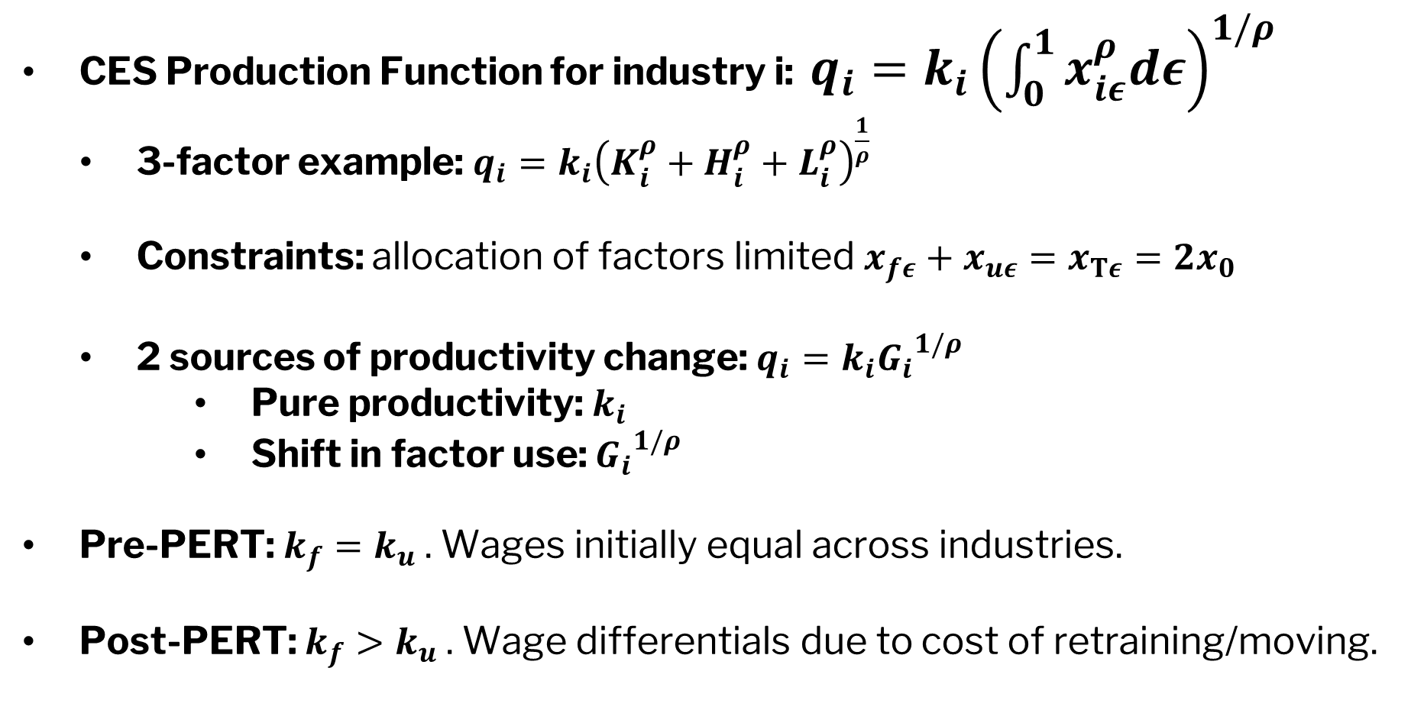
CES Production Framework with Productivity Shock
CES Production Function for industry i: $q_{i}=k_{i}{\left(\int_{0}^{1}{x_{iε}^{ρ}dε}\right)}^{1/ρ}$
  3-factor example: $q_{i}=k_{i}{\left(K_{i}^{ρ}+H_{i}^{ρ}+L_{i}^{ρ}\right)}^{\frac{1}{ρ}}$
  Constraints: allocation of factors limited $x_{fε}+x_{uε}=x_{Tε}=2x_{0}$
  2 sources of productivity change: $q_{i}=k_{i}{G_{i}}^{1/ρ}$
      Pure productivity: $k_{i}$
      Shift in factor use: ${G_{i}}^{1/ρ}$
Pre-PERT: $k_{f}=k_{u}$ . Wages initially equal across industries.
Post-PERT: $k_{f}>k_{u}$. Wage differentials due to cost of retraining/moving.
CES Production Model

Slide 26
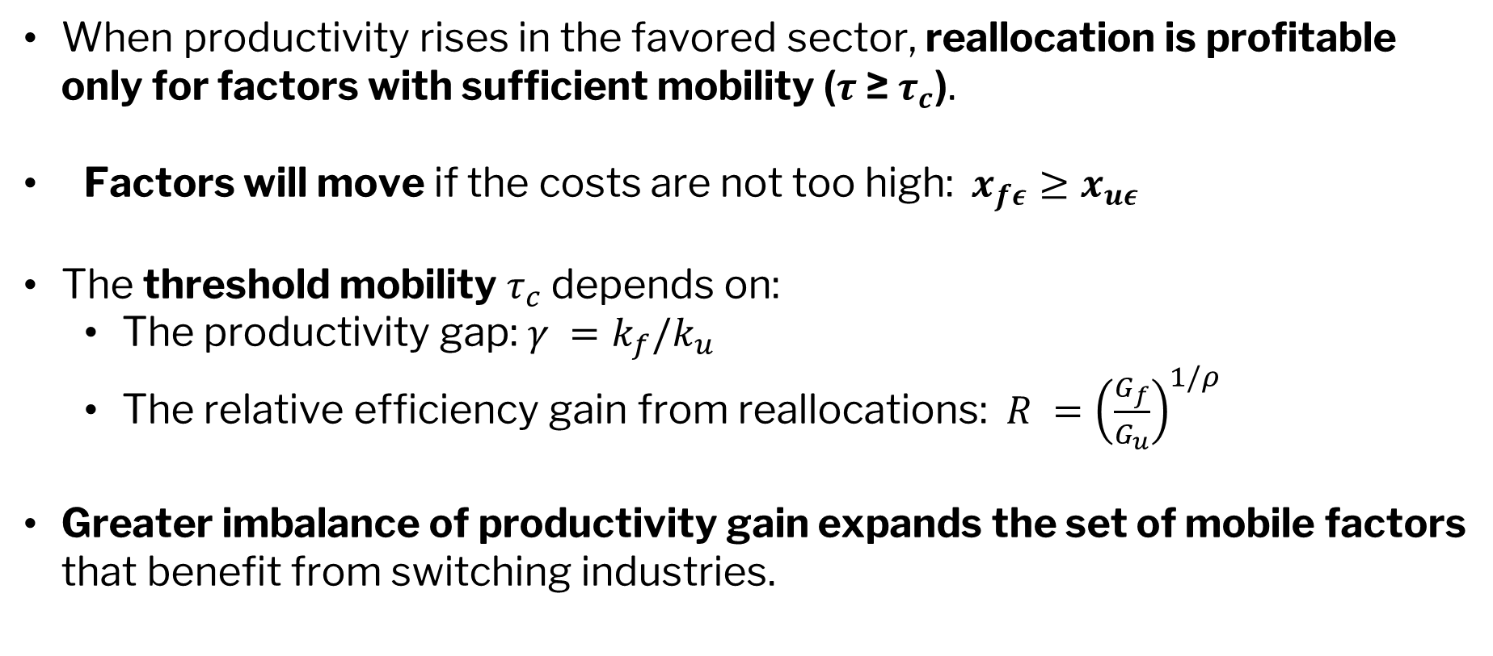
Wages and Factor Movement After PERT
When productivity rises in the favored sector, reallocation is profitable only for factors with sufficient mobility ($τ$≥ $τ_{c}$).
Factors will move if the costs are not too high: $x_{fε}≥x_{uε}$
The threshold mobility $τ_{c}$ depends on:
  The productivity gap: $γ =k_{f}/k_{u}$
  The relative efficiency gain from reallocations: $R ={\left(\frac{G_{f}}{G_{u}}\right)}^{1/ρ}$
Greater imbalance of productivity gain expands the set of mobile factors that benefit from switching industries.

Slide 27
The relationship between wages and mobility levels in two industries following the introduction of an unbalanced PERT
The balanced portfolio at any level of mobility always wins with the PERT.
Higher elasticities of substitution produce greater gains for the most mobile assets.
Note that after the initial shock of the “disruption,” forces emerge for new equilibrium where returns to human capital (imperfectly mobile) decrease in the favored industry as mobility increases, while the change in returns in the losing industry increase.

Slide 28
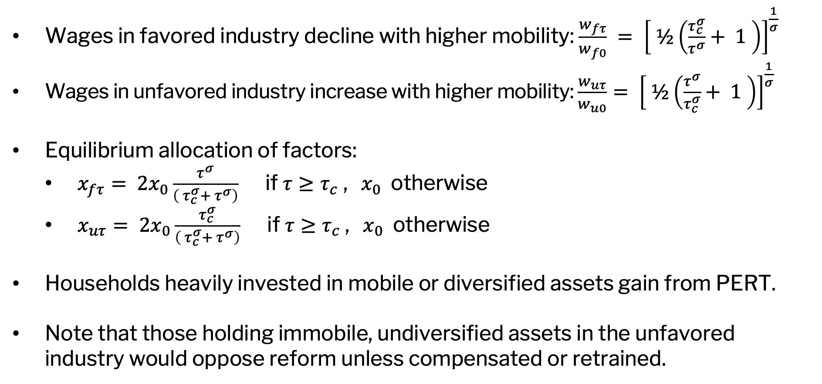
Asset Portfolios, Equity, and Sources of Resistance
Wages in favored industry decline with higher mobility: $\frac{w_{fτ}}{w_{f0}} = {\left[ ½\left(\frac{τ_{c}^{σ}}{τ^{σ}}+ 1 \right)\right]}^{\frac{1}{σ}}$
Wages in unfavored industry increase with higher mobility: $\frac{w_{uτ}}{w_{u0}}= {\left[ ½\left(\frac{τ^{σ}}{τ_{c}^{σ}}+ 1 \right)\right]}^{\frac{1}{σ}}$
Equilibrium allocation of factors:
  $x_{fτ}= 2x_{0}\frac{τ^{σ}}{\left( τ_{c}^{σ}+ τ^{σ}\right)}$ if $τ≥τ_{c}$ , $x_{0}$ otherwise
  $x_{uτ}= 2x_{0}\frac{τ_{c}^{σ}}{\left( τ_{c}^{σ}+ τ^{σ}\right)}$ if $τ≥τ_{c}$ , $x_{0}$ otherwise
Households heavily invested in mobile or diversified assets gain from PERT.
Note that those holding immobile, undiversified assets in the unfavored industry would oppose reform unless compensated or retrained.

Slide 29
Propositions
Proposition 1: Perfect mobility of household assets eliminates the need for compensation to make the household at least indifferent to the unbalanced PERT.
Proposition 2: Perfect diversification of household assets eliminates the need for compensation to make the household at least indifferent to the unbalanced PERT.
Proposition 3: With either only mobile assets or fully diversified immobile assets, a household has no incentive to block the unbalanced PERT — no incentives for rent-seeking.
Proposition 4: Returns to perfectly mobile assets are equalized across industries, but households with unbalanced portfolios of human capital assets may experience differential returns and may require a PEST (e.g., retraining) to support mobility.
PROPOSITIONS

Slide 30
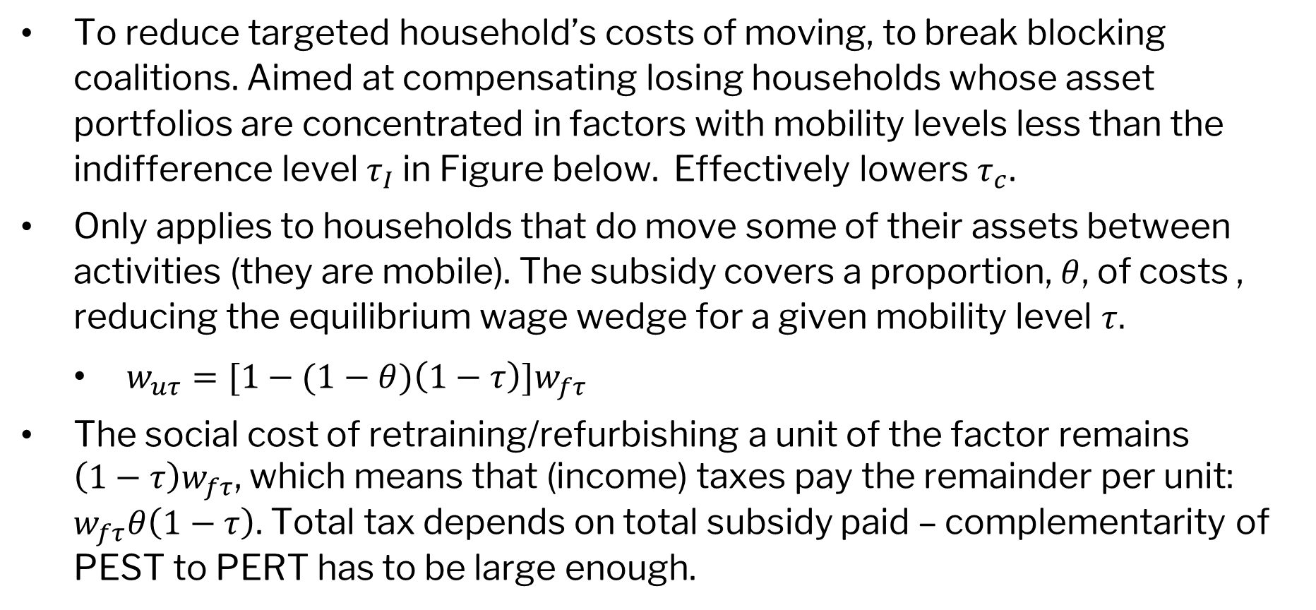
A Smart Retraining Compensatory PEST
To reduce targeted household’s costs of moving, to break blocking coalitions. Aimed at compensating losing households whose asset portfolios are concentrated in factors with mobility levels less than the indifference level $τ_{I}$ in Figure below. Effectively lowers $τ_{c}$.
Only applies to households that do move some of their assets between activities (they are mobile). The subsidy covers a proportion, $θ$, of costs , reducing the equilibrium wage wedge for a given mobility level $τ.$
  $w_{uτ}=[1−(1−θ)\left(1−τ\right)]w_{fτ}$
The social cost of retraining/refurbishing a unit of the factor remains $\left(1−τ\right)w_{fτ}$, which means that (income) taxes pay the remainder per unit: $w_{fτ}θ\left(1−τ\right)$. Total tax depends on total subsidy paid – complementarity of PEST to PERT has to be large enough.

Slide 31



The relationship between wages and mobility levels in two industries following the introduction of an unbalanced PERT and retraining PEST.
Returns increase for the most mobile
PEST increases competition.
$τ_{I}$ with subsidy
Returns decline for the most immobile
$τ_{c}$ with subsidy
without subsidy
$τ_{c}$ without subsidy

Slide 32
Propositions
With the increase in mobility induced by a retraining/refurbishing PEST, while the total size of the pie shrinks relative to a stand-alone PERT, we find that:
Proposition 5: Within a range of lower levels of mobility, retraining intensifies competition and lowers returns in the favored industry but, importantly, raises returns in the unfavored.
Proposition 6: Immobile assets in industries favored by the PERT will experience positive changes in returns, while those in unfavored industries will face negative changes.
Proposition 7: The compensatory PEST complements the PERT by shifting more assets to the higher productivity sector.

Slide 33
Smart vs Unsmart PESTs
Targeted to a group more probable to support the PERT.
Unsmart compensatory policies are politically but not economically complementary to PERT.
Such a PEST (unsmart) which fails to satisfy the sunsetting property could become a socially-costly property right for those who are subsidized.
Typical, unsmart PEST is an industry-targeted subsidy. Taxes/subsidy to protect industries, imprecisely targeted.
Unsmart PEST leans against the PERT: potential economic complementarity to PERT not captured.

Slide 34
Political Power: Two Critical Propositions
Political power, as John Kenneth Galbraith¹ emphasized, is both the obstacle to and the instrument of good governments.
From Galbraith’s perspective, good governments require using political power to limit and discipline power itself. This currently does not exist in the patrimonialism of the current U.S. governmental executive branch.
In a world in which countervailing democratic power does not exist, a ”power trap” may arise as reflected by two critical propositions from our conceptual framework for smart governments.
Proposition 8: Unbalanced but inclusive PERTs (a Pareto move) might appear benign, given that all households gain something, but in a dynamic setting, the PERT selection process can itself be captured, leading to a process of widening inequality of wealth distribution.
Proposition 9: Once an imbalance in wealth between groups is established, it propagates, leading to future unbalanced, directed pie-expansion PERTs and even more inequality in the distribution of wealth.
¹Galbraith, John Kenneth. The New Industrial State. Houghton Mifflin, 1967.
Notes:
Footnote to his book

Slide 35
Salute
Our association owes much to the remarkable career of John Kenneth Galbraith:
  PhD awarded in 1934 from UC Berkeley (precursor to ARE),
  First and only faculty member for a single year at UC Davis in 1933-34 and listed as heads of Departments of Economics, of Agricultural Economics, of Accounting and of Farm Management.
  AEA President in 1972, UC Berkeley Alumni of the Year in 1985;
  Author of seminal works, including:
    American Capitalism; The Concept of Countervailing Power; The Great Crash of 1929; The Affluent Society; The New Industrial State; Economics and the Public Purpose; The Age of Uncertainty; The Anatomy of Power; Ambassador’s Journal
His remarkable career extended well beyond the typical boundaries of academic economists. We all wished we had his remarkable influence, but few of us can reach his height (six foot nine) and his remarkable writing skills.
Notes:
Footnote to his book

Slide 36
